Slide 1
Diyala University / College of Education for Humanities
Asst . Inst. Eman Ahmed Hasson
Methods of Teaching English
Second Grade
The Seventh Lecture
Provide Opportunities for Students to Communicate in English
fullslidesppt.com _ 30+ Ready Made PowerPoint Templates with Google Slides for Free

Slide 2
How Do EFL/ESL Teachers Provide Opportunities for Students to Communicate in English?
Some teachers who aim at having communicative classroom , begin lesson with what Littlewood calls “precommunicative activities". He discusses two kinds of precommunicative activities-structural and quasi-communicative.

Slide 3
Example of providing opportunities for students
The teacher’s goal was to teach students how to ask about fruit an vegetables likes and dislikes.

Slide 4
The teacher first taught a grammatical item then she began by giving several examples as this one:
Statement : You like (to eat) kiwi.
Question : Do you like (to eat) kiwi?

Slide 5
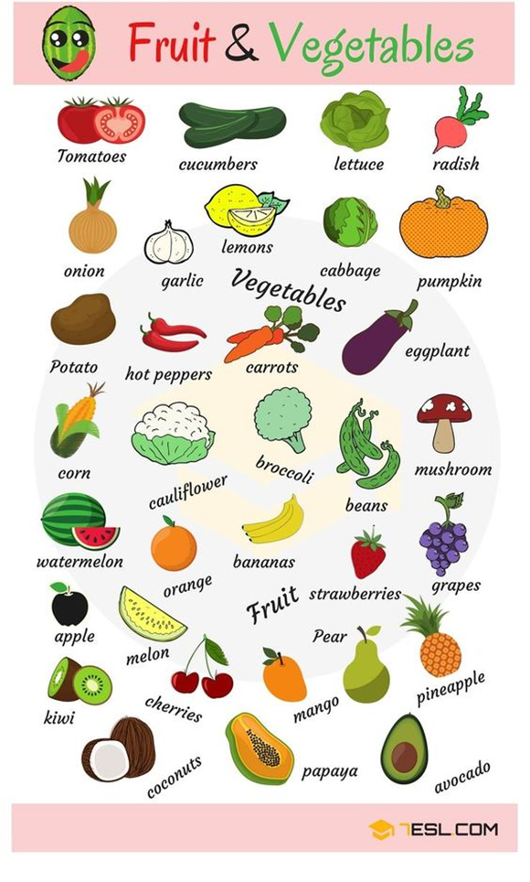

Slide 6
What make a communicative classroom communicative?
1-Reduction in the centrality of the teacher.
2-An appreciation for the uniqueness of individuals.
3-Chances for students to express themselves in meaningful ways.
4-Choices both in relation to what students say and how they say it

Slide 8
Thank you

